Slide 1
Welcome to AP World History
Ms. Downey

Slide 2
On your notecard – Fill out the following:
Name:
Class Period:
Grade:
Birthday:
Two Favorite Subjects:
Extracurricular Activities:
Would you rather OWN a dragon or BE a dragon? Make sure you explain why!

Slide 3
What KO Needs you to know from handbook

Slide 4
School Reminders
Tablet Roll-out is next Monday, 8/26.
NO CASE – NO TABLET. PERIOD.
Pay KORC ASAP if you already know it’s lost in the abyss.
Dress Code in the handbook has changed some…
Ladies, if we can’t see your shorts under that shirt, you’re in violation. (KO RULE!)

Slide 5
Who is Your Teacher
Former Klein Oak Graduate
Graduated from Texas Tech University and Stephen F. Austin State University.
Favorite country is AMERICA… but England is a close second.
Exercise, Cooking, Reading, Football, and the normal TV shows we all watch…

Slide 6
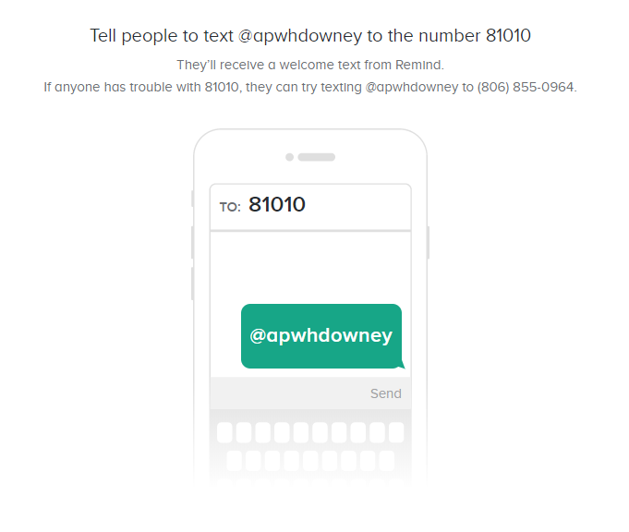
Best Ways to Contact me
E-mail – bdowney1@kleinisd.net
Twitter AND Instagram - @DowneysClass
Website – https://downeysclass.weebly.com
Before School @ 6:30 – I TRY MY BEST TO BE HERE
Remind: Please use your first and last name when you sign up!

Slide 7
Class Vowels
Ask Questions!
Engage fully in learning.
Integrate new info.
Open up to new ideas and opinions.
Use what you learn.

Slide 8
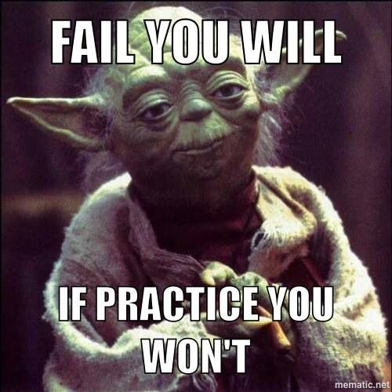
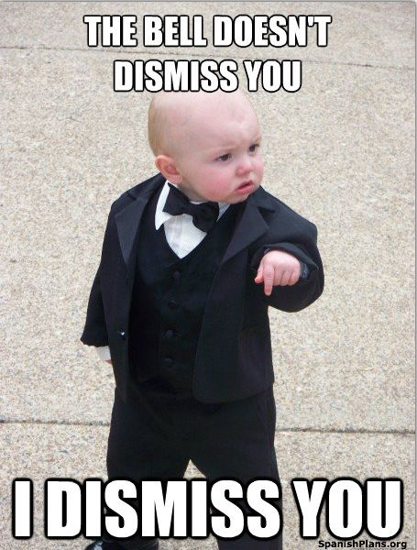
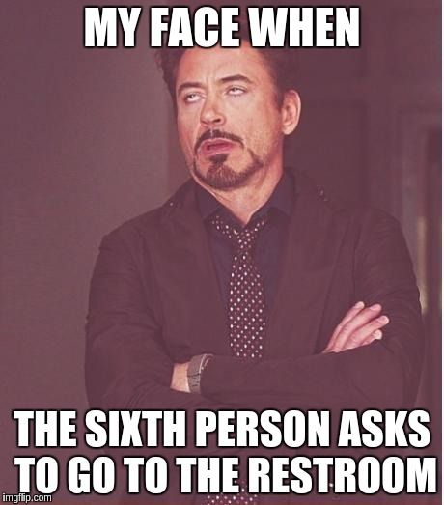
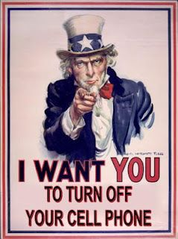
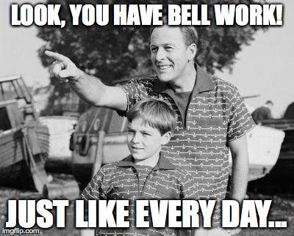
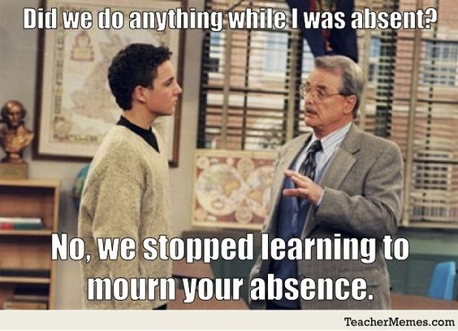
Things to Re “MEME” Ber

Slide 9
What do you need for this class?
Always assume positive intentions. I’M NOT OUT TO GET YOU!
Be prepared to come to class to learn and to contribute to discussions and group work.
Ask questions if you are confused and express concerns or opinions in a RESPECTFUL manner.
Laptop – EVERYDAY
Something to write with – EVERYDAY
Your brain and an open mind.

Slide 10
Let’s Look At the Syllabus
“Quick Overview”

Slide 11
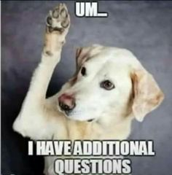
Questions?

Slide 12
Let’s Learn About You

