Slide 1
Bell Ringer
Name THREE facts from yesterday’s discussion about the Paleolithic Era that you didn’t know before.

Slide 2
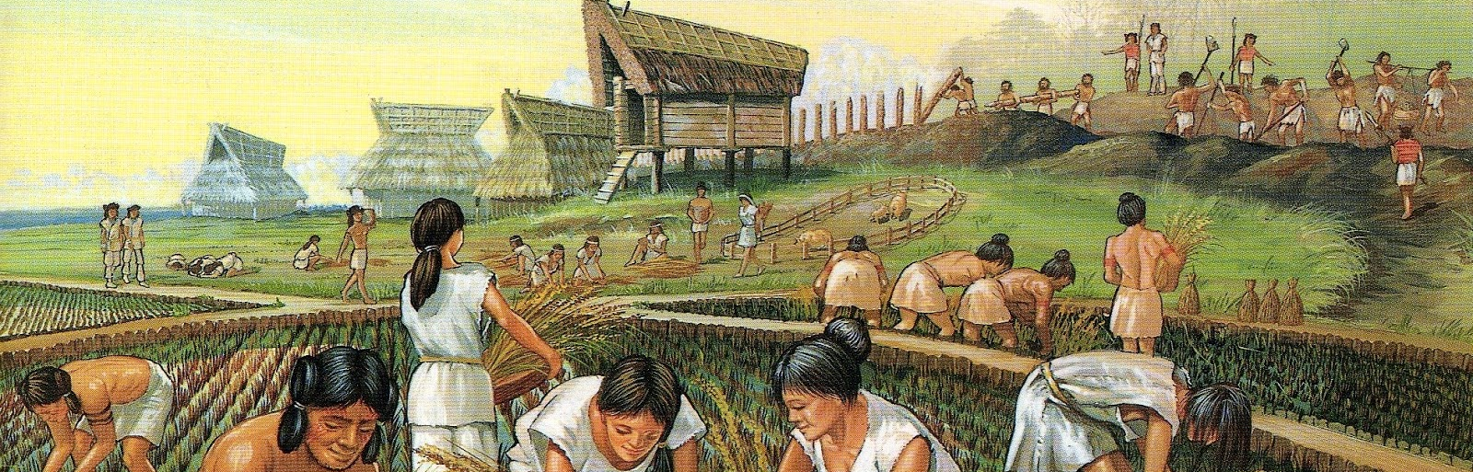
The Neolithic Period
(Foundations, 8000 BCE to 600 BCE)

Slide 3
Breakthroughs to Agriculture
Agriculture is the second great human process after settlement of the globe.
called the Neolithic (New Stone Age) or Agricultural Revolution
transformed human life across the planet.
new relationship between humans and other living things
shaping the landscape
selectively breeding animals
many domesticated plants and animals came to rely on humans

Slide 4
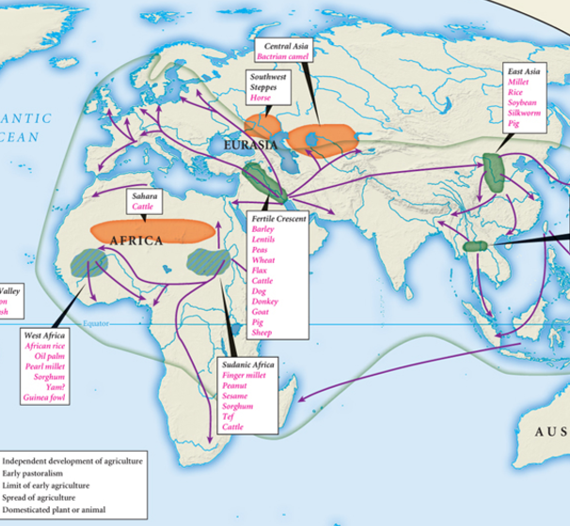
Common Patterns
Agricultural Revolution happened independently in several world regions.
coincided with the end of the last Ice Age
Gathering and hunting peoples had already learned some ways to manage the natural world.
Women were probably the agricultural innovators.
started to establish more permanent villages

Slide 5
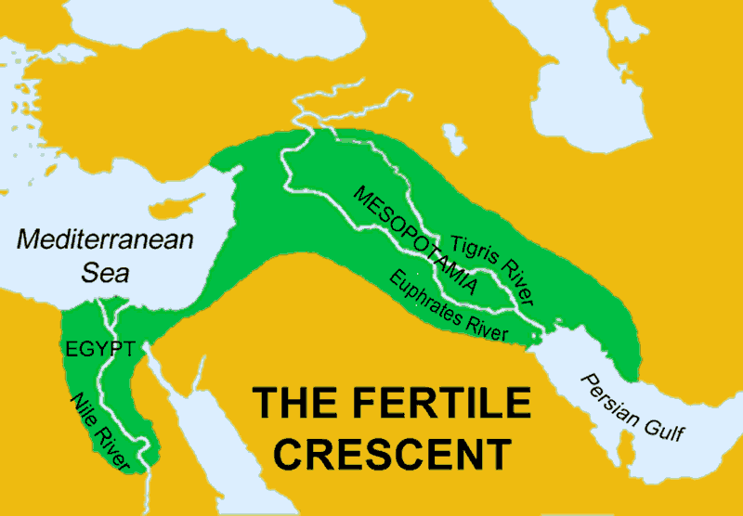
Variations
Agriculture developed in a number of regions, with variation.
depended on the plants and animals that were available
The Fertile Crescent was the first to have a full Agricultural Revolution.
Separate development of agriculture took place at several places in the Americas.
absence of animals available for domestication
lacked cereal grains, instead relied on maize or corn
oriented north/south, practices had to adapt to distinct climate zones

Slide 6
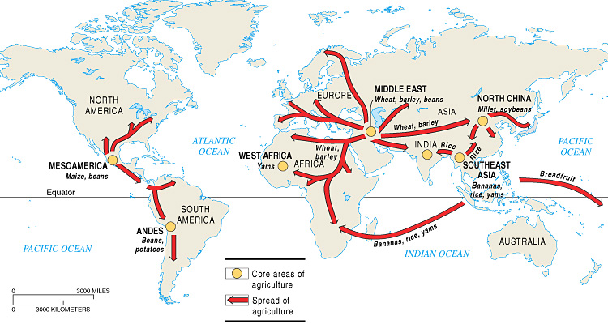
Globalization of Agriculture
The spread of agriculture occurred in two ways.
Diffusion
colonization or migration of agricultural peoples
Language and culture spread with agriculture.
By the beginning of the Common Era, gathering and hunting peoples were a small minority of humankind.

Slide 7
Culture of Agriculture
Agriculture led to much greater populations.
Changes in world population were dramatic.
10,000 years ago: around 6 million people
5,000 years ago: around 50 million people
There were large effects on the environment.
fields and grazing land replaced forests and grasslands
Farming did not necessarily improve life for ordinary people.
There was an explosion of technological innovation

Slide 8
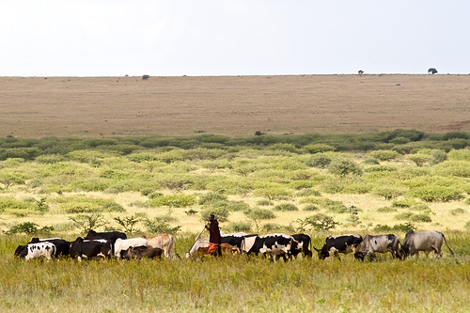
Pastoral Societies
Some regions relied much more heavily on animals, because farming was difficult or impossible.
central Asia, the Arabian Peninsula, the Sahara desert, parts of eastern and southern Africa.
Relations between nomadic herders and their faming neighbors an enduring theme in Afro-Eurasia.
often conflict as pastoralists sought access to agricultural products and competed for land
Relative equality between men and women persisted in pastoral societies.

Slide 9
Agricultural Societies
These societies maintained equality and freedom.
Çatalhüyük, in southern Turkey provides a good example
population: several thousand
no streets; people moved around on rooftops
many specialized crafts, but little sign of social inequality
women were relatively equal to men
agricultural societies flourished
organized by kinship or lineage groups
elders sometimes sought to exploit labor of young members

